Slide 1

By
Ruchitha Padigapati(46281236)
Vara Lakshmi(46282339)
Surekha Kachana(46281313)
Lavanya Koyya(46282340)
Kalpana Challagundla(46282338)

Slide 2
CONTENT
Introduction
Requirements
Problem Statements
Functional Specifications
Technical Specifications
Flow chart
Modules
Benefits
Conclusion

Slide 3
INTRODUCTION
Project Management System is a Model for overseeing the execution of a project. The project management system provides structure and control of the project environment .
It is design to help business and individual track projects , task and schedules.
The employee and manager can register and login to the system by providing the required credentials.
The data provided by employees and manager will be stored in a file.

Slide 4
REQUIRMENTS
Problem Statement.
Functional Specifications.
Technical Specifications.

Slide 5
PROBLEM STATEMENT
The proposed solution is to plan, execute and track project of any size.
The system is used to set project timelines and milestones, track progress and manage the team’s entire workload all in one place
The system will replace the paper system into a digital system which would not require any hard copies and physical space for record keeping.

Slide 6
FUNCTIONAL REQUIRMENTS
• All records are saved in a file.
• Key features of the system are:
a)Register as new user: Any new employee should be allowed to register to the system.
b)Login as user: Existing users can login to the system and perform the operations.

Slide 7
TECHNICAL SPECIFICATION
• Use data-structures for storing data before adding it to file (i.e, Linked list).
• Data Validation is implemented for phone number, email id, username, password,
manager id, employ id.
• Write optimized logic for searching as time complexity should not get increased while
searching any information.
• For this we can store all the data in a file.

Slide 8
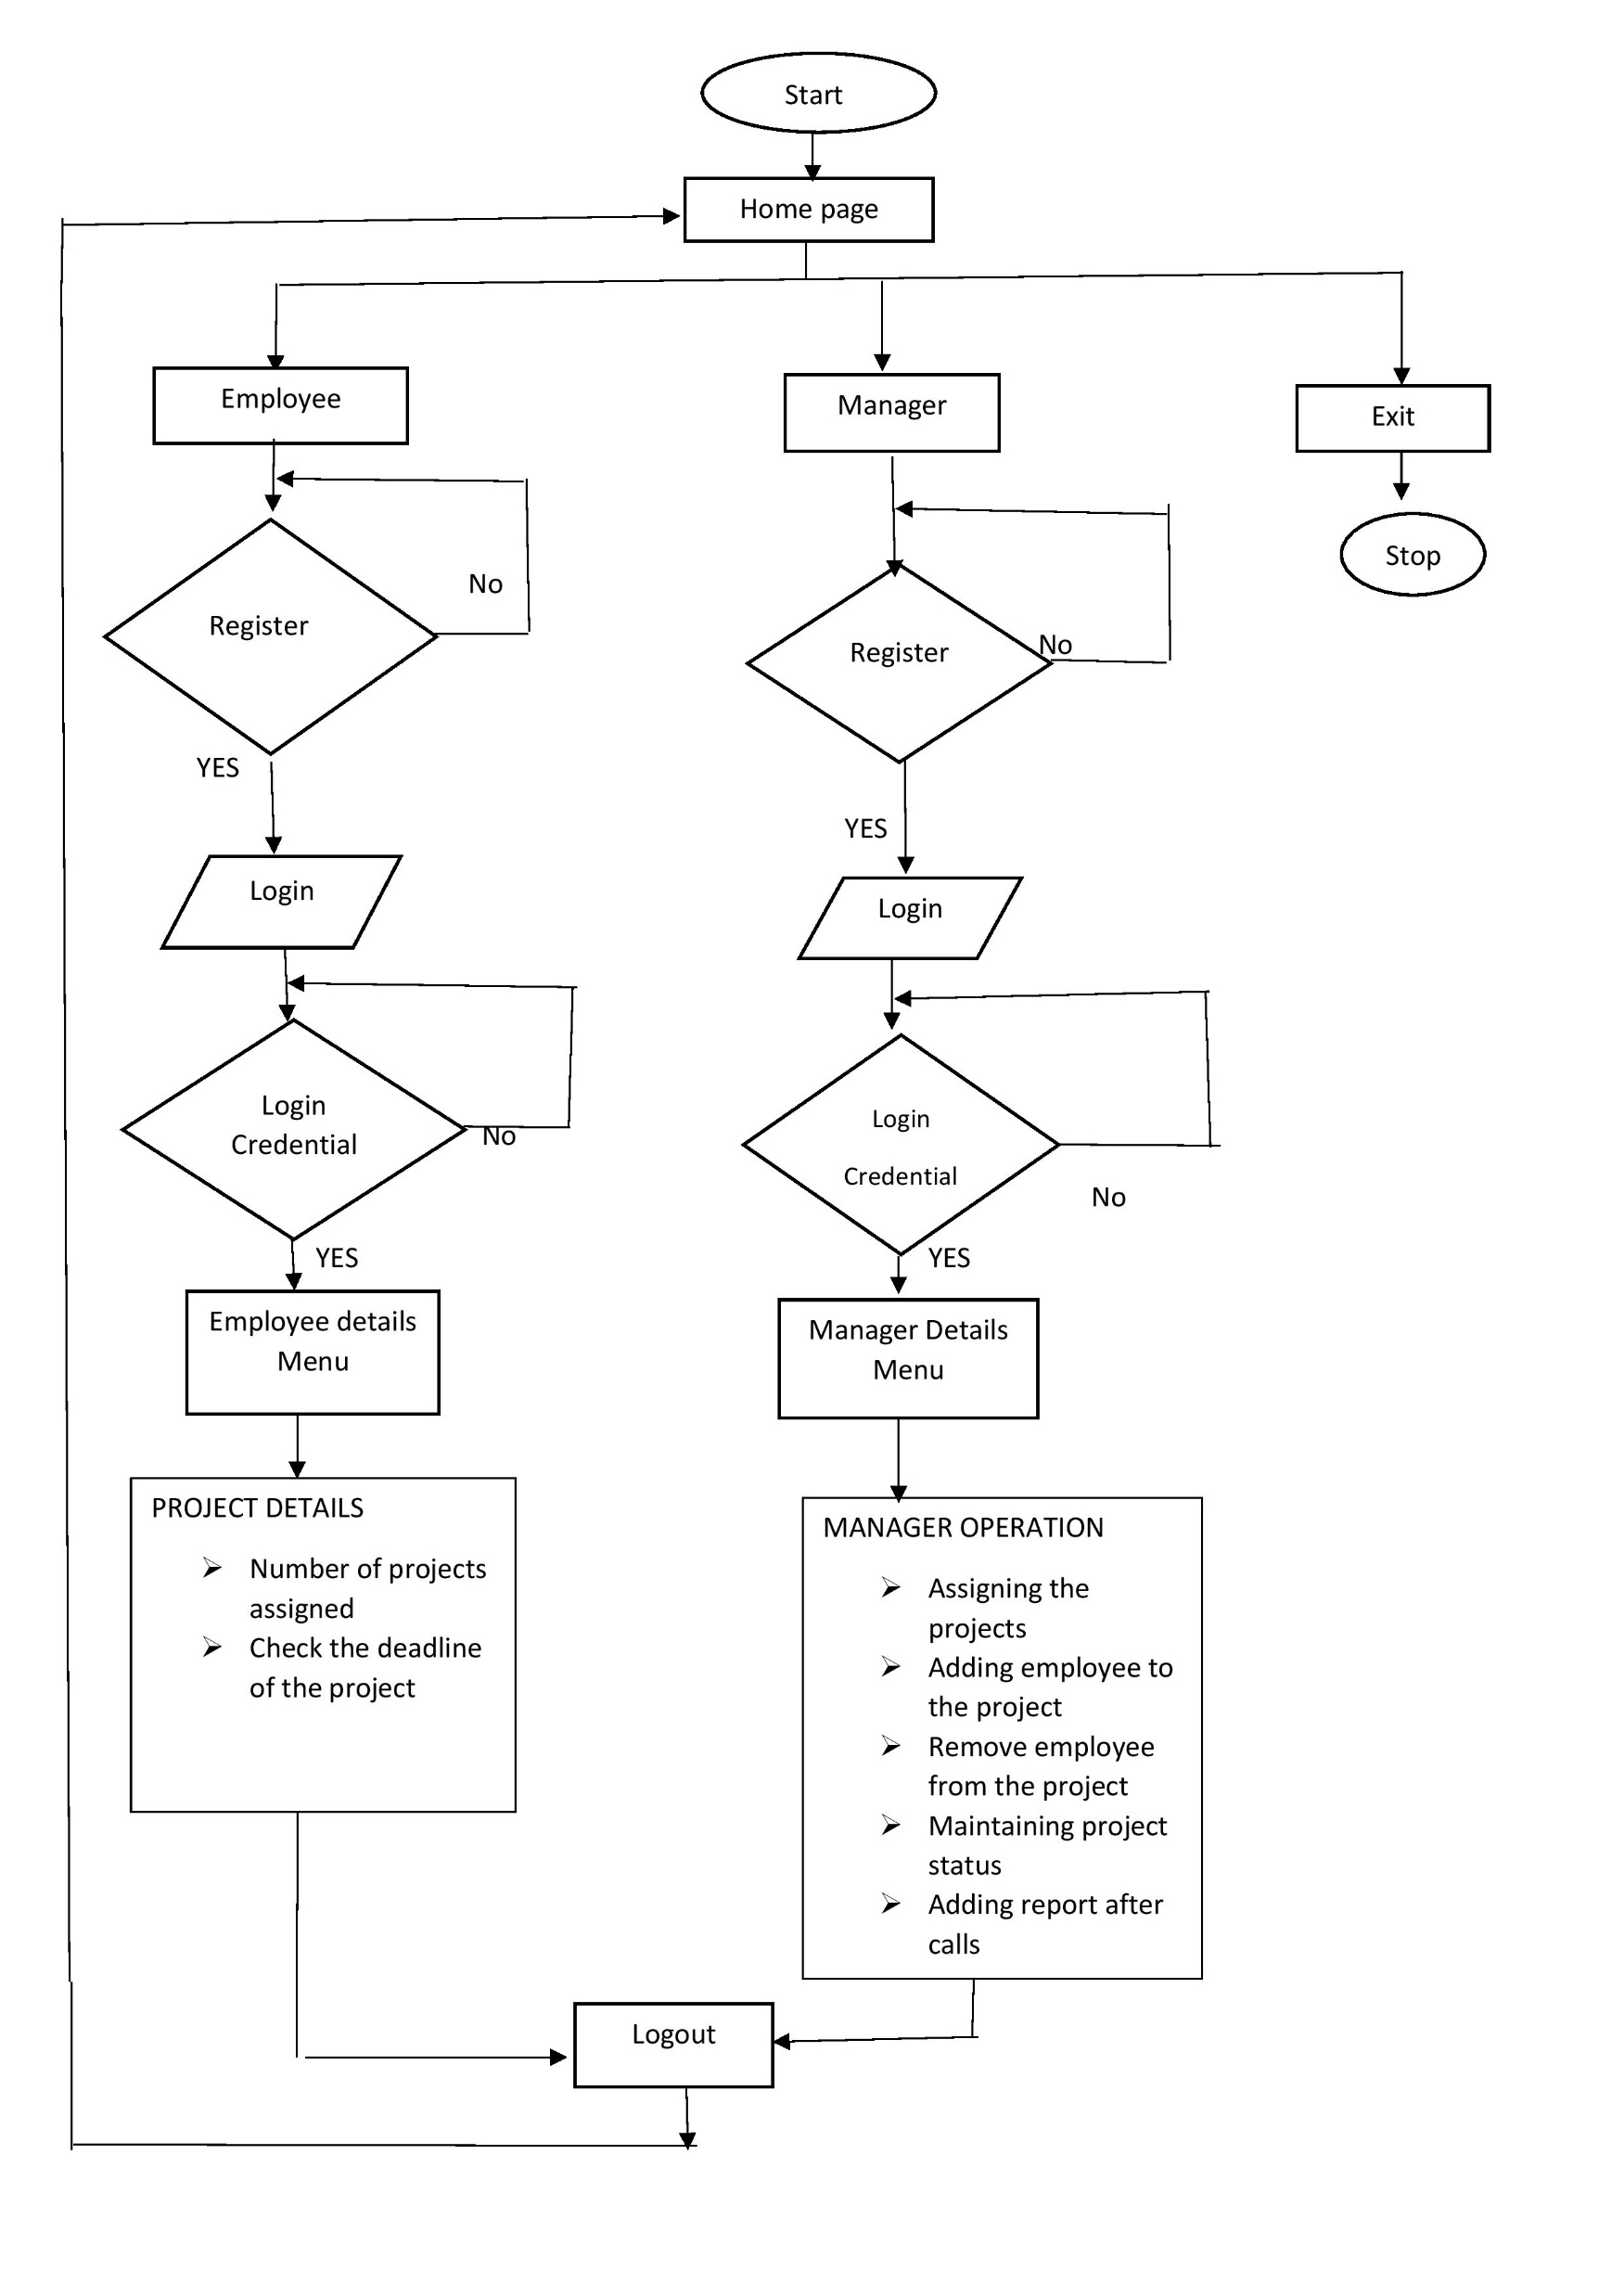
FLOWCHART

Slide 9
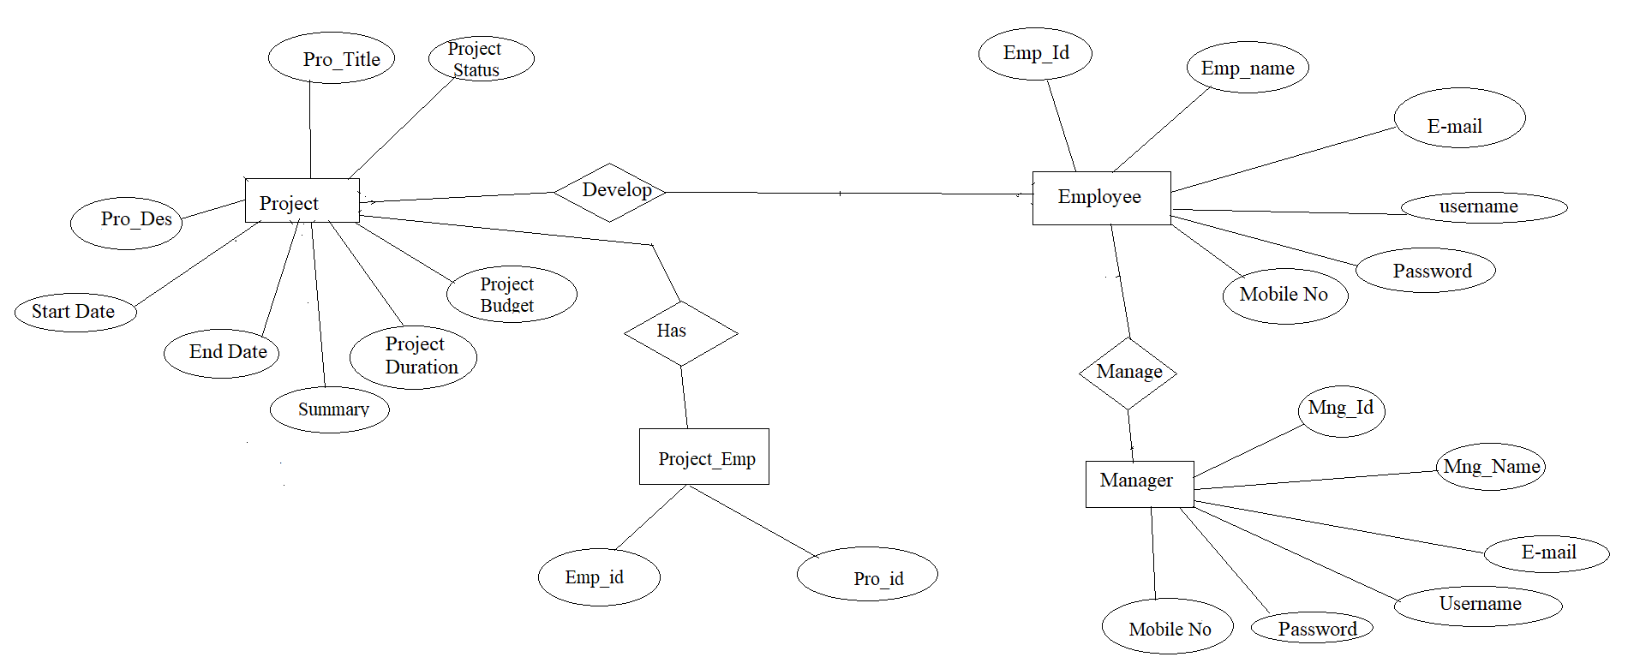
ER DIAGRAM

Slide 10
MODULES
There are 3 modules in this System
Employee Module
Manager Module
Data Validation Module

Slide 11
EMPLOYEE MODULE
Employee can login and check his project details.
Employee can we how many projects he is assigned its end date his co-workers .

Slide 12
MANAGER MODULE
Manager needs to take care of adding employees to projects, delete project, remove employee from project.
When the project is completed, assign its status as closed and adding report after meeting calls.

Slide 13
DATA VALIDATION MODULE
Data validation is the process of verifying and validating data that is collected before it is used.
Any type of data handling task, whether it is gathering data, analysing it, or structuring it for presentation, must include data validation to ensure accurate results.
In the proposed system, data validation is done for username, password, email id, phone number, employee id, manager id of admin, company and applicant module.

Slide 14
TECHNOLOGIES USED
System C
C is a powerful general-purpose programming language. It can be used to develop software like
operating systems, databases, compilers, and so on.
Data Structures
Data Structures in C are used to store data in an organised and efficient manner. The C
Programming language has many data structures like an array, stack, queue, linked list, tree, etc.
Data structures make it easy for users to access and work with the data they need in appropriate
ways.
Linux
Linux is a Unix-like, open source and community-developed operating system (OS) for computers,
servers, mainframes, mobile devices and embedded devices. An operating system is the software
that directly manages a system's hardware and resources, like CPU, memory, and storage.

Slide 15
BENEFITS
Automation of entire process
Saves time
Accessibility.

Slide 16
TOOLS USED
gcc
makefile
vim editor

Slide 17
CONCLUSION
In this Project Management System, it helps in detail which tasks will be accomplished, who will be involved in completing the tasks and when tasks should start and finish.

Slide 18
THANK YOU

